Slide 1
Azure Cosmos DB
Notes:
{Opening greeting}

Slide 2

Data will grow to 44 ZB in 2020
Today, 80% of organizations adopt cloud-first strategies
AI investment increased by
300% in 2017
Notes:
In our market research, we continue to see 3 major trends disrupting and impacting the world around us.
The first trend is the explosion of Data. Data is continuing to grow and not stopping any time soon. By 2020, data will reach 44 zettabytes (ZB) which is QUADRUPLE what it is today.
The second major trend is cloud adoption. Four out of every five companies invest in public cloud strategies.
The third major trend is artificial intelligence. AI is giving life to all of that data we’re creating. This year alone, investment in AI has increased 300%.
1 ZB = 1000 Exbyte = 1 million PB
1 Yottabyte = 1 ZB

Slide 3
Cloud
DATA
CLOUD
AI
Notes:
We see the convergence of cloud, data, and AI coming together to fuel break-through innovations.
Today any company to be successful they have to harness the power of Data, Cloud and AI
The volume of data continues to explode because of data from sensors, social media, apps, and data found across the enterprise within documents, Excel files, and CRM systems, for example.
AL Examples – maps, calendar reminders,

Slide 4
Modern apps face new challenges
Managing and syncing data distributed around the globe
Delivering highly-responsive, real-time personalization
Processing and analyzing large, complex data
Scaling both throughput and storage based on global demand
Offering low-latency to global users
Notes:
Azure Cosmos DB vision is to be the database for all planet-scale applications and scenarios.
The picture I want you to take away is this.
Build planet-scale databases without worry.
Model the data the way your application needs it to be.
Use the API, tools and framework that you are familiar with.

Slide 5

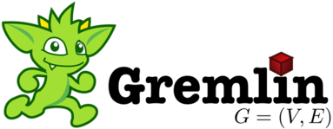




Azure Cosmos DB
A globally distributed, massively scalable, multi-model database service
Table API
MongoDB
Column-family
Document
Key-value
Graph
Elastic scale out
of storage & throughput
Guaranteed low latency at the 99th percentile
Five well-defined consistency models
Turnkey global distribution
Comprehensive SLAs
Notes:
Ram + Bharath
Cosmos DB support accessing your data using multiple APIs. Most of our customers use the native SQL API but we also support Mongo/Gremlin/Cassandra at a wire protocol level.
This means that if you have existing applications which use these APIs, all you need to do is change the connection string and point to Cosmos DB and your application would work . Additionally, you would also get other benefits of Cosmos DB like elastic scaling, global distribution etc.

Slide 6












































Azure Cosmos DB customer spanning industries

Slide 7
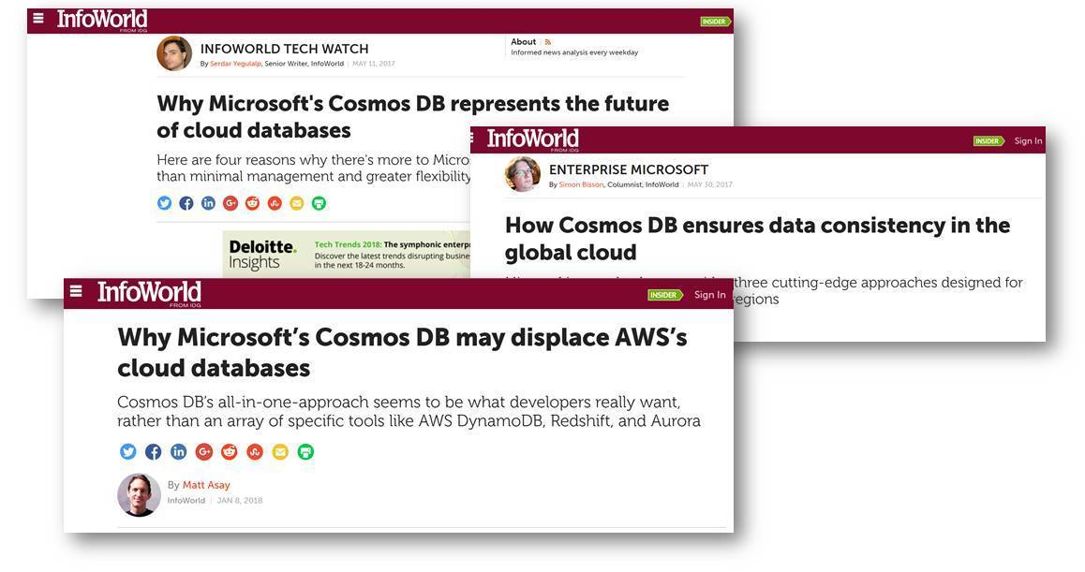
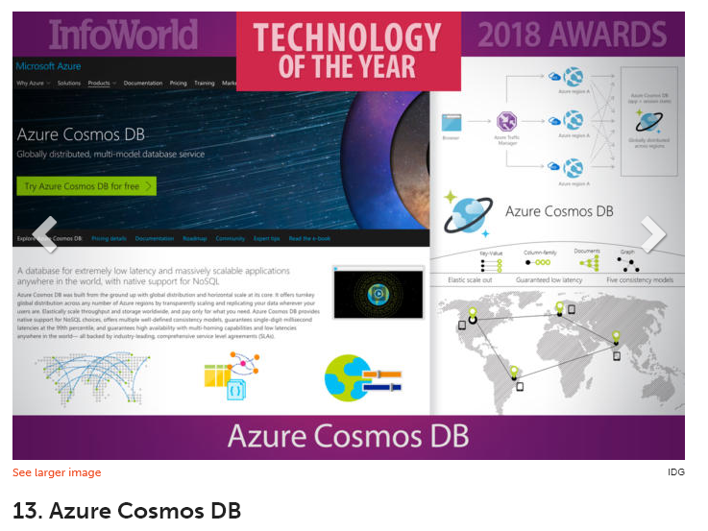
Voices of press

Slide 8
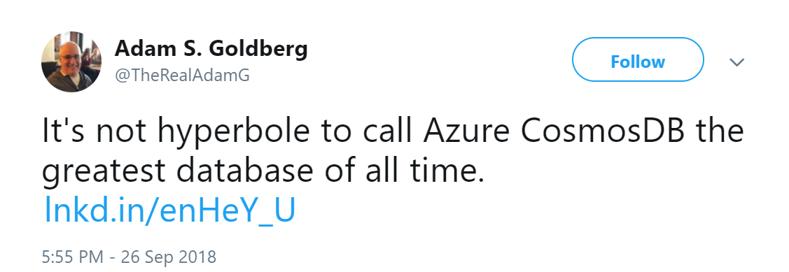
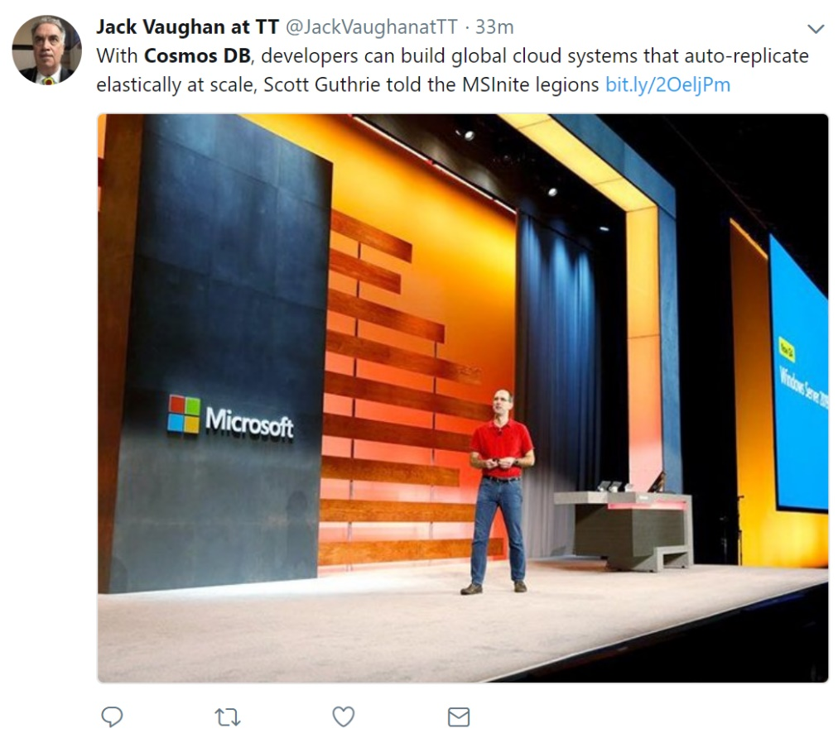


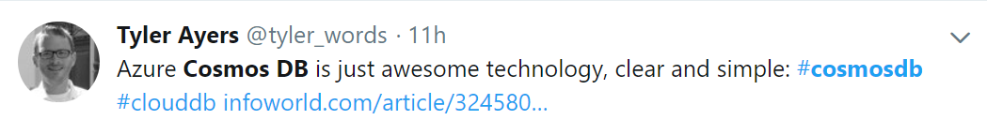
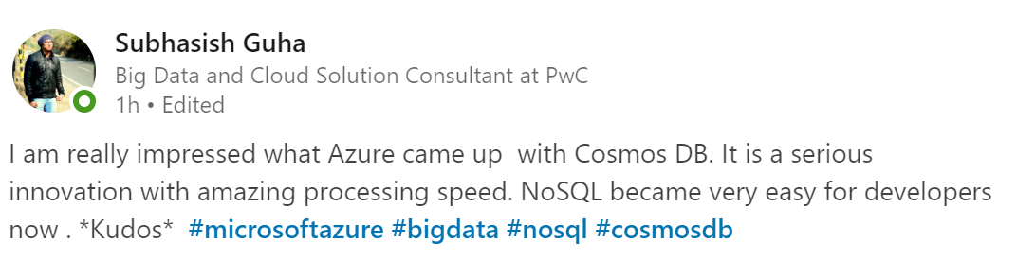

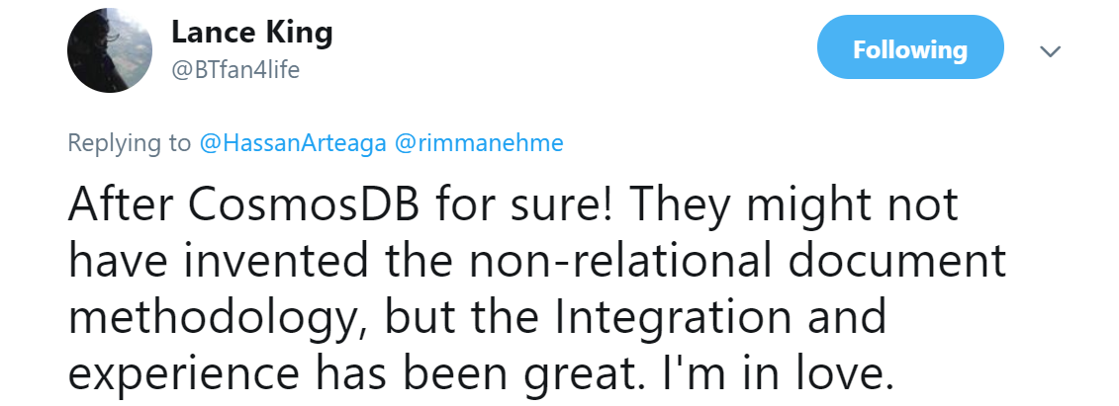
Voices of developers

Slide 9
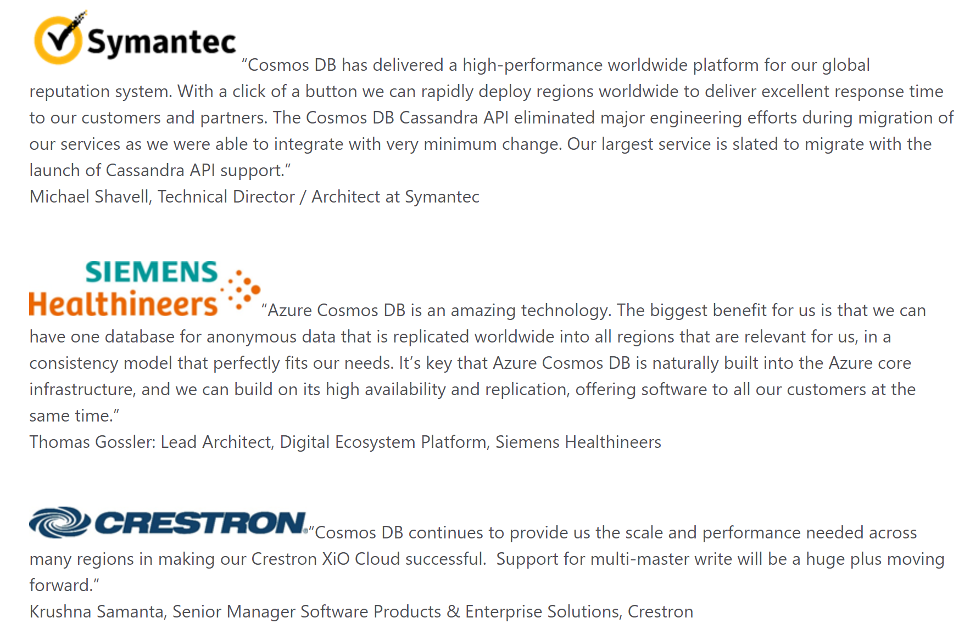
Voices of our customers

Slide 10
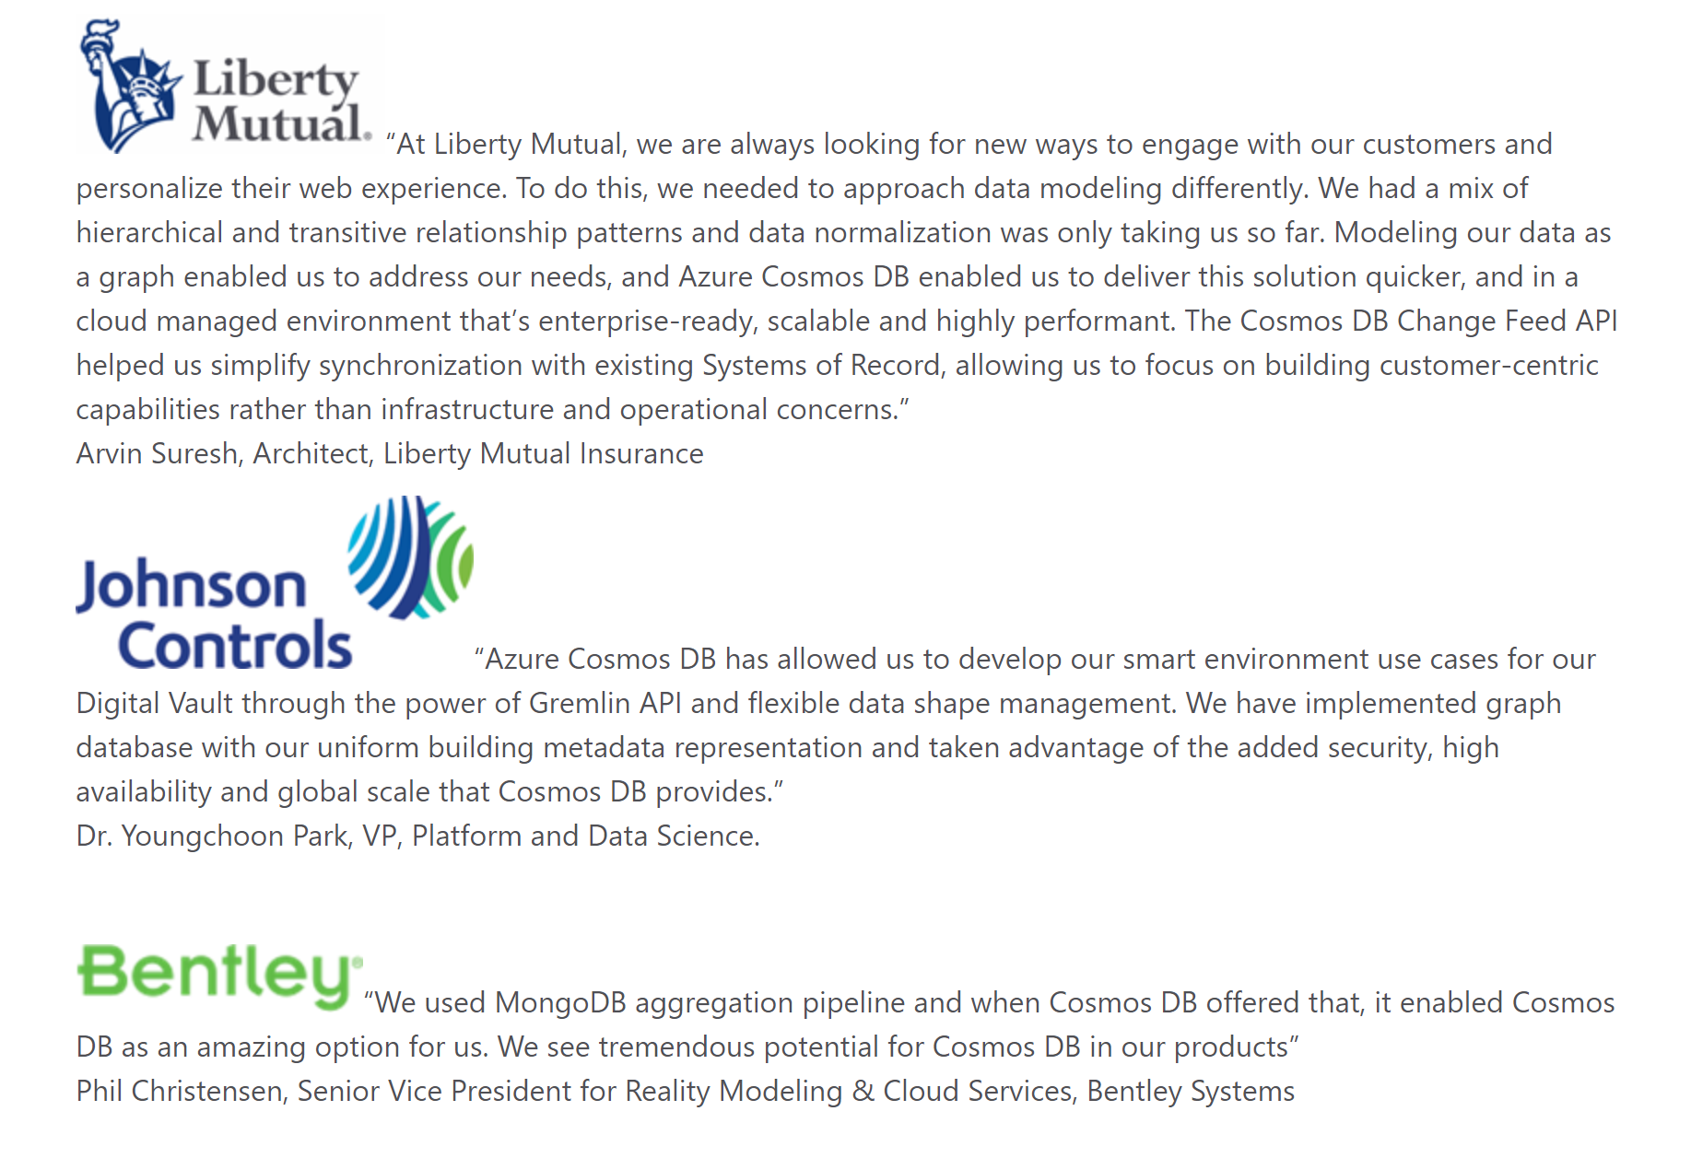
Voices of our customers

Slide 11
What’s in it for Capgemini
Cosmos DB has $1B target for FY20 and we see massive opportunity!
We are interested in closely partnering with CapGemini and enroll you as our preferred partner and a hit-list of potential customers to go after.
We will provide Capgemini direct engineering support and embed you with the Cosmos engineering team
Capgemini will be able to reuse Coke-NSR solution pattern with other customers
Capgemini will be able to train their engineers on Cosmos DB by working with the Cosmos team in delivering the NSR solution for Coke.
Success of NSR solution will build the credibility and trust. It is crucial for Capgemini to deliver it in time.

Slide 12
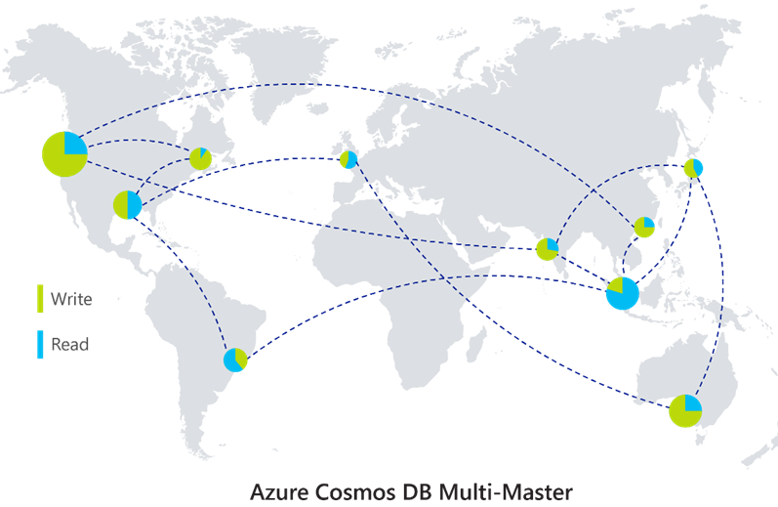
Turnkey Global Distribution : Put your data where your users are
Worldwide presence as a Foundational Azure service
Automatic & synchronous multi-region replication
Provides Active-Active Multi-Master support
Manual and automatic failovers
Designed for High Availability, Low Latency, High Scalability
Flexible and Comprehensive Conflict Resolution
Notes:
Cosmos DB is a Foundational (Ring 0) Azure service
Available in all Azure regions by default, including sovereign/government clouds
Transparent and automatic multi-region replication
Associate any number of regions with your database account, at any time
Policy based geo-fencing
Multi-homing APIs
All endpoints are logical, by default
Apps don’t need to be redeployed during regional failover
Apps can also access physical endpoints if needed
Support for both manual and automatic failover
Designed for high availability
Allows for dynamically setting priorities to regions
Simulate regional disasters via API
Test the end-to-end availability for the entire app (beyond just the database)

Slide 13

Turnkey Global Distribution : Put your data where your users are
Worldwide presence as a Foundational Azure service
Automatic & synchronous multi-region replication
Provides Active-Active Multi-Master support
Manual and automatic failovers
Designed for High Availability, Low Latency, High Scalability
Flexible and Comprehensive Conflict Resolution
68
Intelligent Cloud
read/write
read/write
read/write
read/write
Intelligent Edge
Multi-Master at global scale
Notes:
Cosmos DB is a Foundational (Ring 0) Azure service
Available in all Azure regions by default, including sovereign/government clouds
Transparent and automatic multi-region replication
Associate any number of regions with your database account, at any time
Policy based geo-fencing
Multi-homing APIs
All endpoints are logical, by default
Apps don’t need to be redeployed during regional failover
Apps can also access physical endpoints if needed
Support for both manual and automatic failover
Designed for high availability
Allows for dynamically setting priorities to regions
Simulate regional disasters via API
Test the end-to-end availability for the entire app (beyond just the database)

Slide 14

Elastic scale out of storage and throughput
12000000
10000000
8000000
6000000
4000000
2000000
Black Friday
Elastically scale storage (GB to PB) and throughput (100 to 100M req/sec) across many machines and multiple regions
Transparent server-side partition management
Automatic expiration via policy based TTL
Pay by the hour, change throughput at any time for only what you need
Provisioned request / sec
Nov 2016
Dec 2016
Time
Hourly throughput (request/sec)
Notes:
A single table can scale from GB-PBs, across many machines, and regions
Transparent server side partition management and routing
Optionally evict old data using built-in support for TTL
Customers pay only for the throughput and storage they need
Elastically scale throughput from 10 to 100s of millions of requests/sec across multiple regions
Customers pay only for the throughput and storage they need
Customers pay by the hour for the provisioned throughput

Slide 15
Guaranteed low latency at P99 (99th percentile)
Requests are served from local region
Single-digit millisecond latency worldwide
Write optimized, latch-free database engine designed for SSD
Synchronous automatic indexing at sustained ingestion rates
Notes:
Unique design of the quorum based replication protocol
Globally distributed with reads and writes served from local region
Well defined consistency models designed to provide precise consistency guarantees
Unique design of database engine
Write optimized, latch-free database engine designed for SSDs and low latency access
Culmination of decades of database system research in marrying the best of NoSQL techniques for the write path with the Relational query optimized data structures concurrent btree on the read/query path
Benchmarked to have the lowest write and read amplifications.
Better performance and TCO compared to all popular log structured engines LevelDB, RocksDB, TokuDB, WiredTiger
Fully resource governed NO WRITE PAUSES
Synchronous and automatic indexing at sustained ingestion rates
No schema or index management needed
No schema versioning needed
No schema migration needed
All of this is highly relevant for rapidly evolving apps in a globally distributed setup
Cosmos DB guarantees low latency access by serving reads and writes from the local regions. This helps your applications to beat the speed of light or network latency across regions.
Nucleus of Cosmos DB is a write optimized, latch-free database engine which is designed for Solid State Drives. The core design point is low latency and performance and global scale.
Cosmos DB indexes all your data automatically, synchronously at sustained ingestion rates. There is no overhead of secondary indexes as with other databases. Most of us know the pain of managing indexes. Now imagine for a moment maintaining, managing, migrating indexes at global scale. It is almost impossible but with Azure Cosmos DB, you don’t have to. At P99 Cosmos DB guarantees <10ms latency for read access and <15ms for write access. Most applications will experience even lower latency of under <2ms for reads and <6ms for writes.
Several of our large scale cloud services at Microsoft uses Cosmos DB for low latency access. All the device telemetry from windows mobile devices is stored in a globally distributed database and with 100s of millions of devices out there, low latency was a key factor in deciding on the right data store.

Slide 16
Guaranteed low latency at P99 (99th percentile)
Requests are served from local region
Single-digit millisecond latency worldwide
Write optimized, latch-free database engine designed for SSD
Synchronous automatic indexing at sustained ingestion rates
Reads
(1KB)
Indexed writes
(1KB)
P99
<10ms
<10ms
Notes:
Unique design of the quorum based replication protocol
Globally distributed with reads and writes served from local region
Well defined consistency models designed to provide precise consistency guarantees
Unique design of database engine
Write optimized, latch-free database engine designed for SSDs and low latency access
Culmination of decades of database system research in marrying the best of NoSQL techniques for the write path with the Relational query optimized data structures concurrent btree on the read/query path
Benchmarked to have the lowest write and read amplifications.
Better performance and TCO compared to all popular log structured engines LevelDB, RocksDB, TokuDB, WiredTiger
Fully resource governed NO WRITE PAUSES
Synchronous and automatic indexing at sustained ingestion rates
No schema or index management needed
No schema versioning needed
No schema migration needed
All of this is highly relevant for rapidly evolving apps in a globally distributed setup
Cosmos DB guarantees low latency access by serving reads and writes from the local regions. This helps your applications to beat the speed of light or network latency across regions.
Nucleus of Cosmos DB is a write optimized, latch-free database engine which is designed for Solid State Drives. The core design point is low latency and performance and global scale.
Cosmos DB indexes all your data automatically, synchronously at sustained ingestion rates. There is no overhead of secondary indexes as with other databases. Most of us know the pain of managing indexes. Now imagine for a moment maintaining, managing, migrating indexes at global scale. It is almost impossible but with Azure Cosmos DB, you don’t have to. At P99 Cosmos DB guarantees <10ms latency for read access and <15ms for write access. Most applications will experience even lower latency of under <2ms for reads and <6ms for writes.
Several of our large scale cloud services at Microsoft uses Cosmos DB for low latency access. All the device telemetry from windows mobile devices is stored in a globally distributed database and with 100s of millions of devices out there, low latency was a key factor in deciding on the right data store.

Slide 17
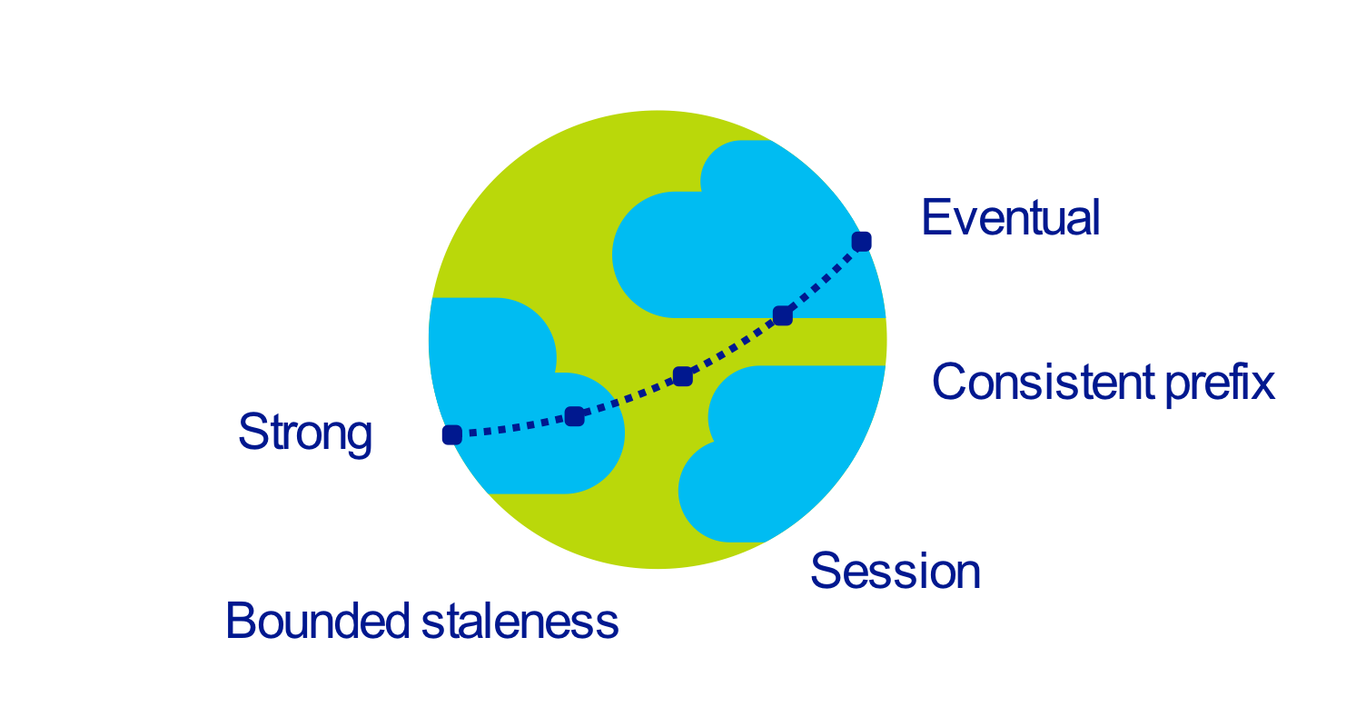
Five well-defined consistency models
Global distribution forces us to navigate the CAP theorem
Offers five consistency levels
Intuitive and practical with clear PACELC tradeoffs
Programmatically change at anytime
Can be overridden on a per-request basis
Notes:
Databases are divided into two categories
Provide extreme choices – strong vs. eventual consistency (e.g., DynamoDB)
Leave everything for developers to configure (e.g., Cassandra)
Read repair, Hinted handoff, quorum sizes, replication topologies etc
Developers have to make precise tradeoffs between
Consistency and availability (during failures)
Consistency and latency (during steady state)
Consistency and throughput (this is important for TCO reasons)

Slide 18
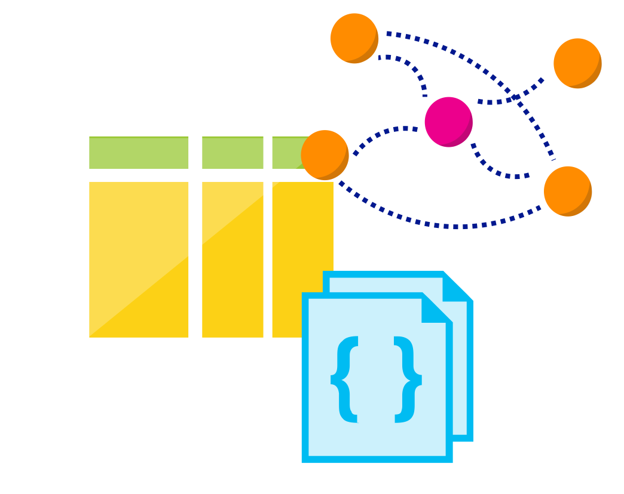
Multi-model, multi-API : Use the model that fits your requirements, and the APIs, Tools and Frameworks you prefer
Database engine operates on Atom-Record-Sequence type system
All data models can be efficiently translated to ARS
Multi-model: Key-value, Document, Column-family and Graph
Multi-API: SQL (DocumentDB), MongoDB, Table, Gremlin, Cassandra
More data-models and APIs to be added
Notes:
Azure Cosmos DB natively supports multiple data models including documents, key-value, graph, and column-family. The core content-model of Cosmos DB’s database engine is based on atom-record-sequence (ARS). Atoms consist of a small set of primitive types like string, bool, and number. Records are structs composed of these types. Sequences are arrays consisting of atoms, records, or sequences.
The database engine can efficiently translate and project different data models onto the ARS-based data model. The core data model of Cosmos DB is natively accessible from dynamically typed programming languages and can be exposed as-is as JSON.
The service also supports popular database APIs for data access and querying. Cosmos DB’s database engine currently supports DocumentDB SQL, MongoDB, Azure Tables(preview), and Gremlin (preview). You can continue to build applications using popular OSS APIs and get all the benefits of a battle-tested and fully managed, globally distributed database service.

Slide 19
Schema-agnostic, automatic indexing : Handle any data without manual schema or index management
At global scale, schema/index management is painful
Automatic and synchronous index management
Hash, range, and geospatial
Works across every data model
Highly write-optimized database engine
Schema
Physical index
Notes:
At global scale, schema/index management is hard
Automatic and synchronous indexing of all ingested content - hash, range, geo-spatial, and columnar
No need to define schemas or secondary indices upfront
Resource governed, write optimized database engine with latch free and log structured techniques
Online and in-situ index transformations

Slide 20
Latency
HA
<10 ms
99.999%
Comprehensive SLAs
99th percentile
Made possible with highly-redundant storage architecture
Guaranteed durability – writes are majority quorum committed
First and only service to offer SLAs on all 4:
Availability (99.999% SLA)
Low-latency (<10ms P99 SLA)
Consistency
Throughput
Throughput
Consistency
Guaranteed
Guaranteed
Notes:
Globally distributed database needs to tackle
latency vs. consistency tradeoffs (in steady state)
availability vs. consistency tradeoff (during failures)
throughput vs. consistency tradeoffs during all times
throughput vs. latency tradeoffs during all times
Simply offering high availability SLAs are not sufficient!
Cosmos DB:
99.99% HA within a single region
99.99 SLA throughput, latency, consistency all at the 99th percentile

Slide 21

Trust your data to industry-leading security & compliance
Always encrypted at rest and in motion
Fine grained “row level” authorization
Network security with IP firewall rules & VNET service endpoint
Comprehensive Azure compliance certification:
ISO 27001
ISO 27018
EUMC
HIPAA
PCI
SOC1 and SOC2 ...
Notes:
As a foundational Azure Service, Security and Compliance is an important aspect of Azure Cosmos DB. Several high value Microsoft services that have stringent compliance and security requirements are built on Azure Cosmos DB. All of the data is encrypted at rest and it is enabled by default. We made sure that we continue to provide the performance guarantees even with encryption enabled and this is transparent to your application.

Slide 22
Building event driven architectures using Azure Cosmos DB Change Feed

Slide 23






Change feed enables reactive programming models for a wide range of scenarios
E-Commerce order processing
IoT telemetry processing
Real-time financial data processing

Slide 24
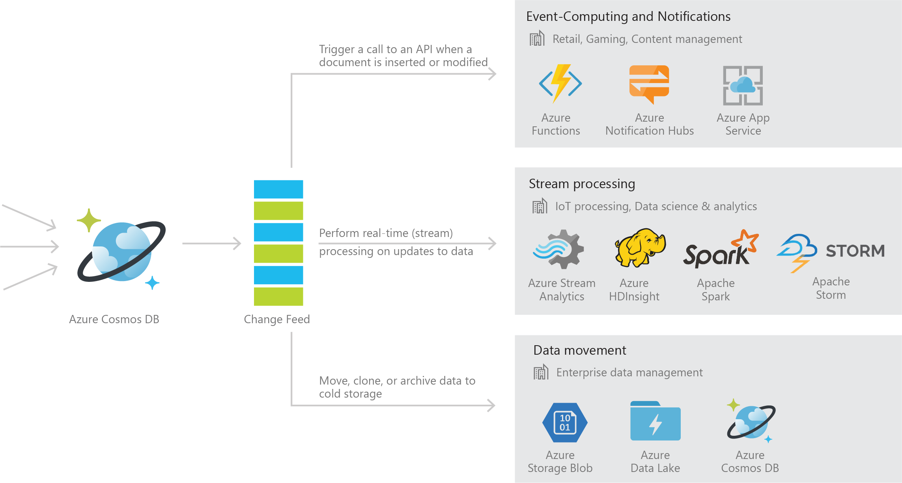
Persistent log of records within an Azure Cosmos DB container in the order in which they were modified

Slide 25


Event Sourcing for Microservices
Trigger Action From Change Feed
Persistent Event Store
Microservice
#1
Microservice #2
New Event
…
Microservice #N

Slide 26
Materializing Views
Application
Cosmos DB
Materialized View
Subscription | User | Create Date | …
123abc | Ben6 | 6/17/17
456efg | Ben6 | 3/14/17
789hij | Jen4 | 8/1/16
012klm | Joe3 | 3/4/17
User | Total Subscriptions
Ben6 | 2
Jen4 | 1
Joe3 | 1

Slide 27
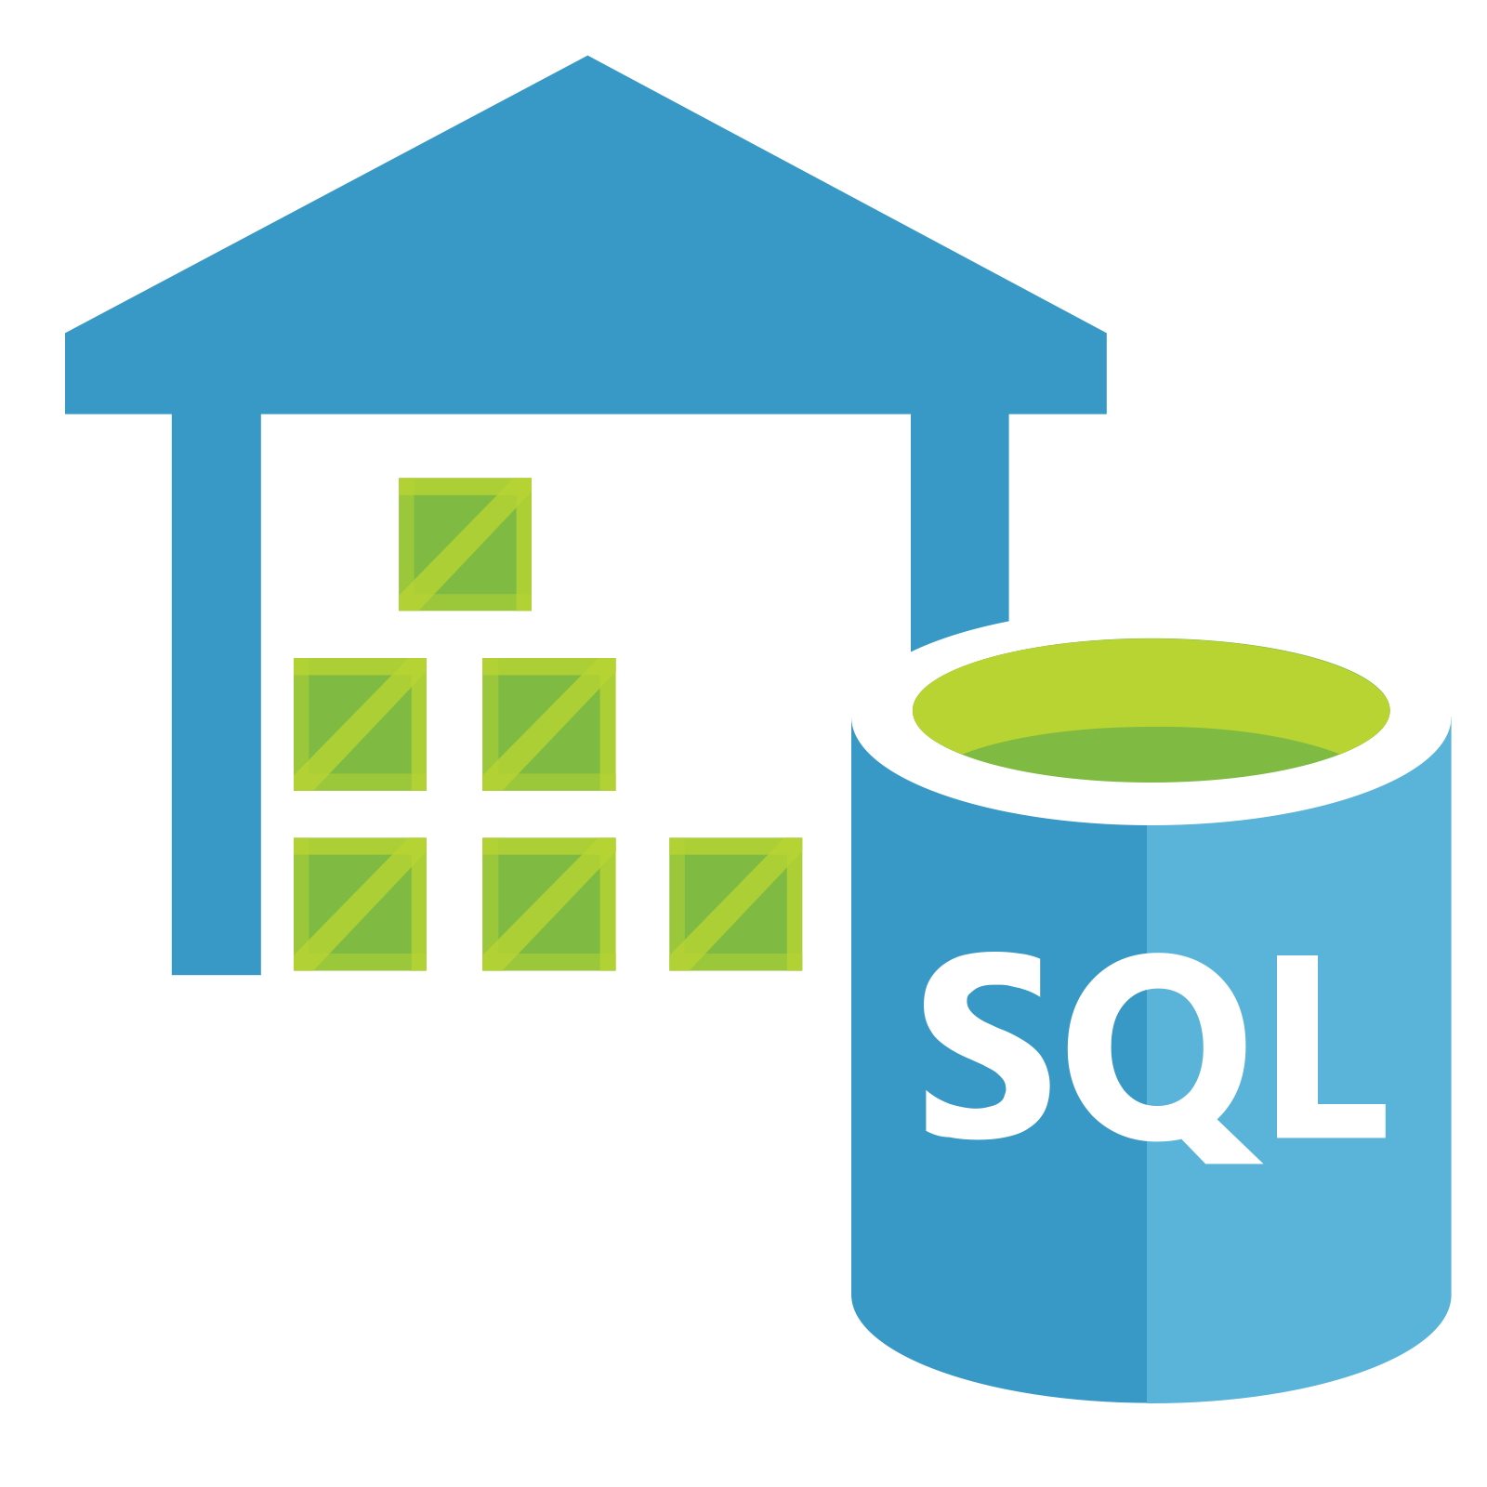

Replicating Data
Secondary Datastore (e.g. archive)
Replicate Records
CRUD Data

Slide 28

Real time financial securities inventory processing
Excerpt from proposed architecture of one of the GSIBs
Current Positions Collection
2 – Read current position
Active Trades Collection
4 – Update new position
Updated position
Trades processor
New trade
3 – Calculate updated position
1 – Read current trade from change feed stream

Slide 29

Operational Analytics on Cosmos DB
Building a data lake with following characteristics:
Hot updateable
Globally distributed
Capability of serving ad-hoc queries at low latency
Notes:
More performant than SDK inserts <Insert stats here>
Automatic throttle handling
Supports multiple sources

Slide 30





Azure Cosmos DB
Apache Spark
Spark master node connects to the Cosmos DB gateway node
Metadata is returned to Spark master node
Query is executed from Spark worker nodes in parallel to the Cosmos DB data nodes
Query results are returned from the Cosmos DB data nodes to the Spark worker nodes.
gateway
node
1
data
nodes
2
master
node
3
Spark-DocumentDB
Connector (Java)
worker nodes
4
Notes:
Accuweather Forecast POC
For example, a web app might need to check that every time a new customer signs up a welcome email is sent, a new user record is created, and their credit card is billed. These functions might be spread over different services or applications and you would want to monitor that each thing happened for each new customer within some SLA, like 30 secs.

Slide 31



Coca-Cola’s NSR (Net Sales Revenue) platform is now live on Azure Cosmos DB
Mission–critical platform responsible for tracking and reporting sold inventory and revenue from bottlers worldwide
Over 20TB of data in first few months of going to production
Core business logic encoded as Spark jobs interacting with Cosmos DB ‘data lake’
Notes:
Accuweather Forecast POC
For example, a web app might need to check that every time a new customer signs up a welcome email is sent, a new user record is created, and their credit card is billed. These functions might be spread over different services or applications and you would want to monitor that each thing happened for each new customer within some SLA, like 30 secs.

Slide 32
Building Lambda architecture pipelines
batch layer
serving layer
The components of a Lambda Architecture
All data pushed into both batch and speed layer for processing
The batch layer has a master dataset (immutable, append-only set of raw data) and pre-compute the batch views
The serving layer has batch views so data available for fast queries.
The speed layer compensates for processing time (to serving layer) and deals with recent data only.
All queries can be answered by merging results from batch views and real-time views.
Source: http://lambda-architecture.net/
pre-compute
batch view
2
3
master dataset
batch view
5
new data
query
1
speed layer
4
real-time view
real-time view
Notes:
Accuweather Forecast POC
For example, a web app might need to check that every time a new customer signs up a welcome email is sent, a new user record is created, and their credit card is billed. These functions might be spread over different services or applications and you would want to monitor that each thing happened for each new customer within some SLA, like 30 secs.

Slide 33




Lambda architecture: Re-architected (lesser moving parts)
1
The components of a Lambda Architecture
All data pushed into Cosmos DB layer for processing
The batch layer has a master dataset (immutable, append-only set of raw data) and pre-compute the batch views
The serving layer has batch views so data for fast queries.
The speed layer compensates for processing time (to serving layer) and deals with recent data only.
All queries can be answered by merging results from batch views and real-time views.
new data
collections
computed RT
CosmosDB change feed
2
master dataset
4
4
3
computed batch
3
pre-compute
batch
5
2
query
Notes:
Accuweather Forecast POC

Slide 34

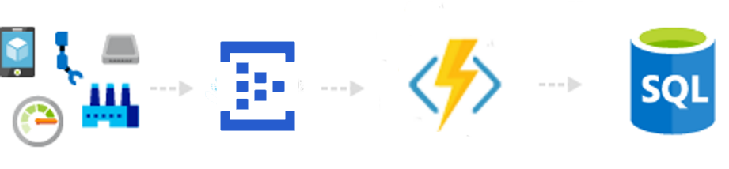
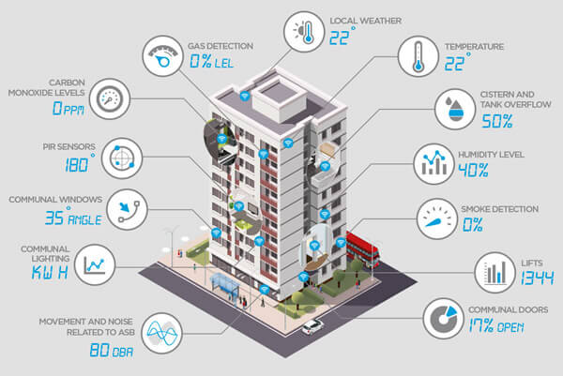
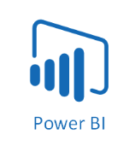


Streaming at scale in Azure using Cosmos DB
Event Hubs
(Message queue)
Azure Function
(Schema conversion, pre-processing)
Azure Cosmos DB (raw event data)
Azure Cosmos DB (materialized view)
Batch processing using Spark SQL and Azure ML
Sensor inputs
CosmosDB change feed
Reporting & Analysis
Stream processing using Spark Structured Streaming
Azure Web App (querying batch & real-time view)
Notes:
- Show single-click deployment demo
- Show how whole system auto-scales on load increase

Slide 35
Customer Stories
Notes:
Speaker Notes:
Just like how customer experience have become critical to the success , your customers expectations have also increase
Your customers have really high expectations.
1) They want to know them and be aware of their context and needs, make it easy to engage with your business whether they are looking to learn more about a product or service or buying from you. And do so in a way that is consistent where they are experiencing your business whether they are home at work on the go. And they want an experience that is fast - milliseconds not minutes is the new measure of wait times.
and fast
References:
https://www.glassboxdigital.com/
2) Accenture Global Consumer Pulse 2013
3) https://blog.kissmetrics.com/speed-is-a-killer/
4) 29% said they are were less likely to buy products if they receive irrelevant marketing (1)
Janrain and Blue Research (http://janrain.com/about/newsroom/press-releases/national-study-shows-consumers-abandon-brands-online-out-of-frustration-with-mistargeting/)
http://www.huffingtonpost.com/entry/dont-let-irrelevant-messaging-cause-your-customers_us_584eddf9e4b0151082221db6

Slide 36





Toyota drives connected car push forward with Azure Cosmos DB
Business need
Need to ingest massive volumes of diagnostic data from vehicles and take real-time actions as part of connected car platform
Management and operations of database infrastructure to handle exponential growth of data
Key benefits
Cosmos DB can scale elastically without operational overhead of MongoDB
Perform fast queries over events to deliver recommended services, safety notices to vehicles
Perform staged migration via MongoDB APIs
Azure HDInsight
Storm
Azure Cosmos DB
Azure Storage
(archival)
8TB
Vehicle Telemetry
250K
Lexus Cars

Slide 37



E-commerce challenger eyes the top spot, runs on Azure Cosmos DB
Business need
Process Ms of retail transactions per second in milliseconds in inventory pipeline during peak (“Black Friday”)
Fast development cycles and loosely coupled micro-services to keep up with a competitive marketplace
Key benefits
Cosmos DB provides elastic scalability from 1-10M requests per second
Improved reliability, and faster order processing times than previous OSS solution
Reduced development time and operational overhead
Azure Cosmos DB
Azure Service Fabric
Inventory Service
Azure Cosmos DB
Azure Service Fabric
Pricing Service
10M
Peak RPS
12TB
Provisioned
64
Databases

Slide 38







Performance at massive scale allows millions to play mobile game
Business need
Handle millions of players on Day 1 due to popularity of the TV series
Match-making of players for competitive and lag-free experience
Provide new content weekly, and iterate on social functionality
Key benefits
Cosmos DB provides elastic scalability for millions of users and flexible schema to support social features and gameplay
Global distribution allows for low latency for players spread worldwide
Automatic indexing used to build real-time leaderboards
Azure CDN
Azure Storage
(game files)
Azure Traffic
Manager
Azure API Aps
(game backend)
Azure Cosmos DB
Azure Functions
Azure Notification Hubs (push notifications)
#1
iOS App Store
1B
Daily Queries
1M
Peak Active

Slide 39
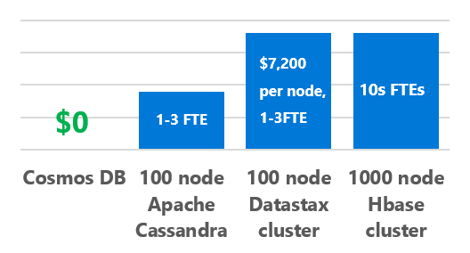
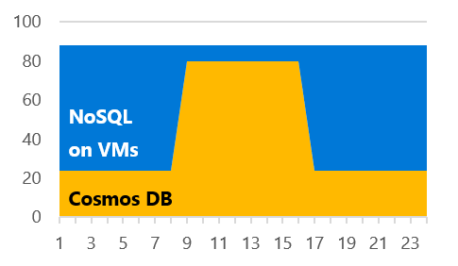
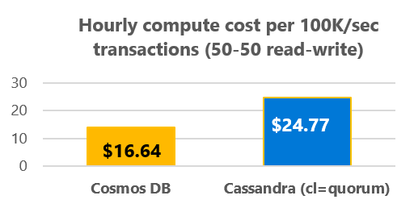
Save vs On-Prem Cassandra
On-prem Cassandra TCO Challenges
TCO Savings with Azure Cosmos DB
Cassandra | Cosmos DB
High DevOps and license fees | No DevOps or license fees Up to 30% savings
No elasticity. Provision for the peak. | Instant and limitless elasticity Up to 40% savings
High datacenter and hardware maintenance costs | Economy of scale, lower cost Up to 40% savings
$41,382/ mo
DSE licenses
4-6x
Savings
$ 30,582 / mo
Electricity
Electricity
Networking
Networking
SSD storage
SSD storage
$ 7,436/mo
Servers
Servers
Bandwidth
Storage
Throughput
6TB workload, 80K TPS, 50-50 read-write split observed among our customers, off-peak to peak ratio is 40%, 1K objects. 4 proc, 4 cores/proc server nodes. Hardware, datacenter costs estimated using Azure TCO calculator for 5 years pro-rated monthly. DSE license assumed $7,200 / year per node (assumes 8 cores). Azure 3Y reserved price was used for Cosmos DB. Findings based on Microsoft calculations.
Data Center
Data Center
18 node (L16) DataStax Cassandra cluster
18 node (L16) Apache Cassandra cluster
Azure Cosmos DB
(3Y reserved)
Notes:
<10ms reads and writes with Azure Cosmos DB multi-master
18 node (L16) DataStax Cassandra cluster ($10,800 DSE licenses, $896 Electricity, $2,540 Networking, $1.146 SSD storage, $9,360 Servers, $16,639 Data Centre)
18 node (L16) Apache Cassandra cluster ($896 Electricity, $2,540 Networking, $1,146 SSD storage, $9,360 Servers, $16,639 Data Centre)
Azure Cosmos DB 1 Yr reserved capacity ($130 Bandwidth, $1,500 storage, $5,806 throughput)

Slide 40
Save vs Cassandra on IaaS
Cloud Cassandra TCO Challenges
TCO Savings with Azure Cosmos DB
Cassandra | Cosmos DB
High DevOps and license fees | No DevOps or license fees Up to 40% savings
Limited elasticity. Over- provisioning | Instant and limitless elasticity Up to 25% savings
Not Cloud-optimized. Poor compute, network, and storage utilization. | Azure-optimized. High compute and network utilization. Up to 40% savings
$28,762/ mo
DSE licenses
>2x
Savings
$17,952/ mo
Bandwidth
Bandwidth
Virtual Machines
and Storage
Virtual Machines
and Storage
$9,924/mo
Bandwidth
Storage
Throughput
6TB workload, 80K TPS, 50-50 read-write split observed among our customers, off-peak to peak ratio is 40%, 1K objects. L16 VMs used per Azure guidance,. DSE license is $7,200 / year per node (assumes 8 cores). Azure monthly consumption prices were used. Findings based on Microsoft calculations.
18 node (L16) DataStax Cassandra cluster
18 node (L16) Apache Cassandra cluster
Azure Cosmos DB
(list prices)
Notes:
18 node (L16) DataStax Cassandra cluster ($10,800 DSE licenses, $130 bandwidth, $17,832 VMs)
18 node (L16) Apache Cassandra cluster ($130 bandwidth, $17,832 VMs)
Azure Cosmos DB ($130 bandwidth, $1,500 storage, $8,294 throughput)

Slide 41
Save vs MongoDB on IaaS
Cloud MongoDB TCO Challenges
TCO Savings with Azure Cosmos DB
MongoDB | Cosmos DB
High DevOps and license fees | No DevOps or license fees Up to 30% savings
Limited elasticity. Over- provisioning | Instant and limitless elasticity Up to 25% savings
Not Cloud-optimized. Poor compute, network, and storage utilization. | Azure-optimized. High compute and network utilization. Up to 40% savings
$16,949/ mo
5-6x
Savings
MongoDB licenses
$12,149/ mo
Bandwidth
Bandwidth
$2,574/mo
Virtual Machines
and Storage
Virtual Machines
and Storage
Bandwidth
Storage
Throughput
2TB workload, 20K TPS, 50-50 read-write split observed among our customers, off-peak to peak ratio is 40%, 1K objects. 4 shards, 3-way replication, L16 VMs used per Azure guidance,. MongoDB license assumed $4,800 / year per node. Azure monthly consumption prices were used. Workload is smaller than Cassandra due to observed reliability/performance challenges with MongoDB at high load. Findings based on Microsoft calculations.
12 node (L16) MongoDB Enterprise cluster w support
18 node (L16) MongoDB cluster
Azure Cosmos DB
(list prices)
Notes:
12 node (L16) MongoDB Enterprise cluster with support ($4.800 MongoDB licenses, $261 bandwidth, $11,889 VMs)
18 node (L16) MongoDB cluster ($261 bandwidth, $11,889 VMs)
Azure Cosmos DB ($261 bandwidth, $500 storage, $2,794 throughput)

